Slide 1


Real-Time Anomaly Detection Using Observability AI/ML
Discover how to leverage Observability AI/ML for real-time anomaly detection, improving system reliability and reducing customer impact.
by Kasiperumal Achappan
Notes:
Welcome everyone to our session on real-time anomaly detection with Splunk MLTK. In today's digital landscape, being able to quickly identify and address anomalies is crucial for maintaining system reliability and minimizing customer impact. Splunk's Machine Learning Toolkit (MLTK) provides powerful capabilities to help us achieve this. We'll explore how MLTK can be leveraged to build robust anomaly detection models that can identify issues in real-time. This will empower us to proactively address problems before they escalate, improving overall system health and the customer experience. The futuristic cityscape on the slide represents the complex, data-driven world we operate in, where MLTK can be a valuable tool for navigating challenges. Let's dive in and discover how Splunk MLTK can transform our approach to anomaly detection.

Slide 2
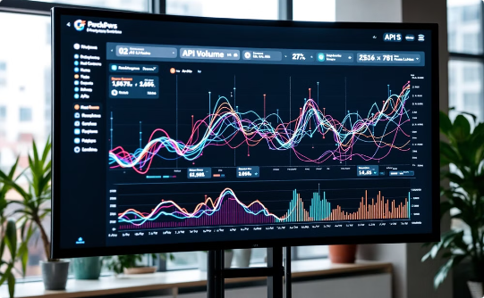
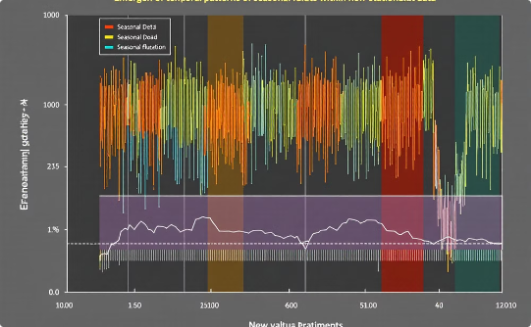
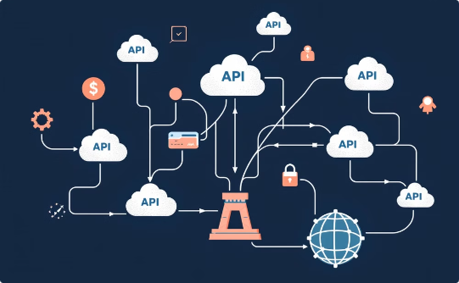
Data Complexity
Our analysis faces several complex data challenges that require sophisticated handling.
Non-Linear Data Patterns
Temporal Characteristics
Multi-API Integration
API volume demonstrates complex trends and fluctuations that don't follow simple linear patterns.
Patterns and seasonality emerge from the noise, creating non-stationary data that changes over time.
Customer journey analysis extends across multiple APIs, adding layers of complexity to our monitoring.
Understanding these complexities is crucial for developing effective insights and making informed decisions.
Notes:
• Our analysis faces some significant data complexities that require sophisticated handling • First, we're seeing non-linear data patterns in the API volume - there are complex trends and fluctuations that don't follow simple linear patterns • Second, the data has strong temporal characteristics, with patterns and seasonality emerging from the noise. This creates non-stationary data that changes over time • And third, our customer journey analysis extends across multiple APIs, adding even more layers of complexity to the data we need to monitor and analyze • Understanding and addressing these data complexities will be crucial for developing effective insights and making informed decisions going forward

Slide 3

Lightweight Models
1
Optimized Resource Efficiency
Streamlined non-statistical models that minimize computational overhead while maintaining accuracy
2
Advanced Time-Series Forecasting
Using Kalman Filter Model for precise, real-time predictions with minimal resource consumption
Notes:
• Lightweight, non-statistical models can provide optimized resource efficiency by minimizing computational overhead while maintaining accuracy. • These streamlined models are well-suited for applications that require fast, real-time processing, like forecasting or embedded systems. • The Kalman filter is an example of an advanced time-series forecasting technique that can provide precise predictions with minimal resource consumption. • Kalman filters work by recursively updating an estimate of a dynamic system's state based on the latest measurements, allowing for accurate forecasts even in the presence of noise or uncertainty. • This approach offers a powerful yet computationally efficient way to track and predict the behavior of complex systems.

Slide 4



Real-Time Alerts
Customer Journey Monitoring
Advanced customer journey monitoring with real-time visualization and response capabilities.
Dashboard
Alerts
Unified view of customer journey volume and response time
Instant notifications of customer journey anomalies
Proactive Analysis
Our integrated dashboard and alert system enables rapid detection of customer journey issues, helping you maintain optimal user experiences.
Notes:
This slide introduces our real-time customer journey monitoring capabilities At the center is an image of a modern data analytics center, with multiple screens displaying customer journey flows and user behavior metrics The key features highlighted are: Dashboard - Provides a unified view of customer journey volume and response times Alerts - Instant notifications of any customer journey anomalies These tools enable proactive analysis, allowing us to rapidly detect and address any issues in the customer journey, ensuring optimal user experiences Our integrated dashboard and alert system is a powerful solution for maintaining visibility and control over the customer experience

Slide 5

Visualizing Anomalies
Real-Time Monitoring Systems
Advanced interactive dashboards provide continuous visibility into system performance, with customizable time series views that update every 30 seconds for immediate detection of critical issues
Smart Pattern Recognition
Machine learning algorithms automatically analyze historical patterns and baseline behavior, triggering color-coded alerts when deviations exceed pre-defined thresholds by more than 2 standard deviations
Notes:
This chart provides a detailed, data-driven view of API volume over time, with a prominent seasonal pattern visible. The vibrant blue line represents the actual API volume, while the dashed gray line shows a Kalman Filter forecast. Scattered orange markers highlight anomalies - deviations from the expected pattern that exceed 2 standard deviations. These real-time monitoring systems give us continuous visibility into system performance, updating every 30 seconds. Advanced machine learning algorithms automatically analyze historical patterns and baseline behavior, triggering alerts when thresholds are exceeded. This allows us to quickly identify critical issues and areas that need further investigation. The clean, minimalist design with a dark background makes the key information stand out clearly.

Slide 6



Predictive Monitoring
Our sophisticated predictive monitoring seamlessly integrates machine learning-powered forecasting with dynamic threshold detection, empowering teams to prevent operational disruptions before they occur.
Monitor
2
Track metrics and analyze performance trends against thresholds
Anticipate
1
Leverage ML algorithms to forecast peak loads and activity patterns
Respond
3
Enable real-time notifications to mission control team
By continuously analyzing historical patterns alongside real-time data streams, we enable organizations to transform their reactive support model into a proactive optimization engine that maintains peak system performance.
Notes:
• Predictive monitoring is a powerful technique that uses machine learning to forecast demand patterns and detect when metrics are approaching critical thresholds. • This allows organizations to be more proactive and prevent operational disruptions before they occur. • The three key components are: - Volume prediction: Forecasting expected volume or demand - Boundary detection: Identifying when metrics are approaching critical levels - Alerting: Proactively notifying teams so they can take action • Accurate volume forecasting helps the business prepare and respond effectively. • Boundary detection identifies potential problems early, before they escalate. • Timely alerts give teams the opportunity to intervene and prevent issues. • By transforming their support model from reactive to proactive, organizations can maintain peak system performance.

Slide 7




Customer Impact
Our continuous focus on service quality creates tangible benefits for customers:
Minimizing Service Disruptions
Ensuring System Reliability
Meeting Service Commitments
Faster Issue Resolution
Proactive monitoring ensures seamless user experience
Enhanced stability delivers consistent performance
Exceeding SLAs maintains customer trust
50% reduction in MTTR improves customer satisfaction
Through this comprehensive approach to service excellence, we continuously work to improve customer experience and maintain the high-quality service our users expect.
Notes:
• Our continuous focus on service quality delivers tangible benefits for customers, including minimizing service disruptions, ensuring system reliability, meeting service commitments, and faster issue resolution. • By proactively monitoring our systems, we can provide a seamless user experience and prevent potential disruptions before they impact customers. • The enhanced stability of our platforms ensures consistent performance, which builds trust and confidence in our services. • Exceeding our SLAs demonstrates our commitment to delivering the high-quality service our customers expect and deserve. • The 50% reduction in mean time to resolution for customer issues has significantly improved overall customer satisfaction. • Through this comprehensive approach to service excellence, we are continuously working to improve the customer experience and maintain the level of quality our users have come to expect from us.

